Slide 1
Vacuum Truck Safe Operation SWP Update

Slide 2
SWP Update: What’s Changed?
Changes in current and future DS&C requirements have driven an amendment to the Americas Products Vacuum Truck Safe Work Practice (504). The good news is the SWP has been reduced in content overall. Fundamental requirements are still contained within.
Per the SDS, Diesel Fuel is considered a flammable material (Note: Currently only in effect within the US. As GHS is rolled out to other countries, this will take effect.)
Reformatted the SWP to the 5 component model template
Removed caution notes (yellow boxes) and recommendations
Added clarity to the Terms and Definitions
Added clarity to the Roles and Responsibilities
Addition of equipment required on a Vacuum Truck
Addition of a form (Vacuum Truck Service Request / Essentials Checklist) and defined when form is required

Slide 3
Examples of Roles and Responsibilities
Contract Owner (CHESM) | Be knowledgeable of the content in this standard and familiar with the relevant Safe Work Practices and CHESM expectations
Qualified Verifier (e.g., Qualified Permit Issuer, Approver) | Review vacuum truck set up and validate that essentials safeguards outlined on the Essentials Checklist are in place prior to starting transfer. Sign on to Essentials Checklist to confirm validation.
Vacuum Truck Contractor Representative (Service Provider manager) | Participate in Loss Prevention Observations (LPO) as required by site. Accountable for maintaining written procedures for safe use of equipment and emergency response. Ensure written safety plans and JLAs supporting daily activities are followed Provide training and certify operators are qualified for duties; maintain training records. Maintain equipment and confirm that all devices required for safe vacuum operations are in good working order. Make repairs prior to further use. Perform scheduled maintenance on equipment based on manufacturer’s recommendations, regulatory standards and requirements specified in this Standard; maintain maintenance records. Supervise and audit vacuum truck operators to confirm personnel performing work are properly trained and following procedures; maintain audit records.

Slide 4
Examples of Terms and Definitions
Combustible Liquids | Liquids having a closed cup flash point at or above 140°F (NFPA 30). Examples of combustible liquids are Kerosene, Fuel Oil and Vacuum Gas Oil.
Flammable Liquids | Liquids having a closed cup flash point below 140°F and a Reid vapor pressure that does not exceed 40 psia (NFPA 30). Examples of flammable liquids are finished grades of gasoline, aviation gasoline, naphtha and crude oil.
Grounding | Providing a means for electrical continuity so currents can dissipate to ground (earth). An electrical resistance of <1000 ohms should be achieved from the ground point to earth. Avoid using process piping, electric motor ground cables, staging, portable walkways and electrical conduit as ground points.
Bonding | Providing electrical connections between isolated conductive parts of a system to equalize their electrical potential (voltage). Electrical resistance between two directly bonded connections should not exceed 10 ohms.

Slide 5
Hazard Assessment for Use of Vacuum Trucks / Systems
When performing a hazard assessment for the use of a Vacuum Truck or Vacuum System, remember recognized hazards must be mitigated in the following order:
Elimination
Substitution: Alternate methods
Engineering Controls: Can the design be changed to eliminate the need for a vacuum truck?
Administrative Controls: Work Permits and Essentials Checklist
PPE

Slide 6
Vacuum Truck Service Request / Essentials Checklist
The Vacuum Truck Service Request form is required for all Vacuum Truck service work.
The Essentials Checklist must be completed when handling material with a flash point of <140 degrees or operating within a classified hazardous location.
The Vacuum Truck Service Request / Essentials Checklist form and a General Work Permit must be completed for the following tasks:
Transferring gasoline or diesel product.
When the equipment (vacuum truck) is within a classified hazardous location.
When moving solids or dry material of any kind.
For multiple days, the form must be replaced daily.

Slide 7
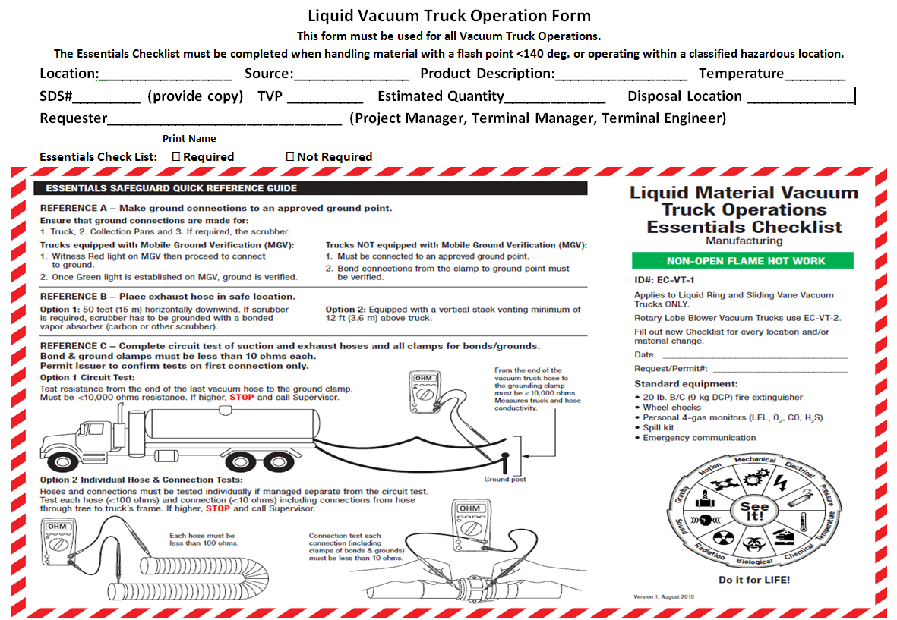
Vacuum Truck Service Request / Essentials Checklist
This section must be completed by the requestor and transmitted to the service provider before the equipment is dispatched.
For easy reference, ohm resistance requirements are listed on this checklist.

Slide 8
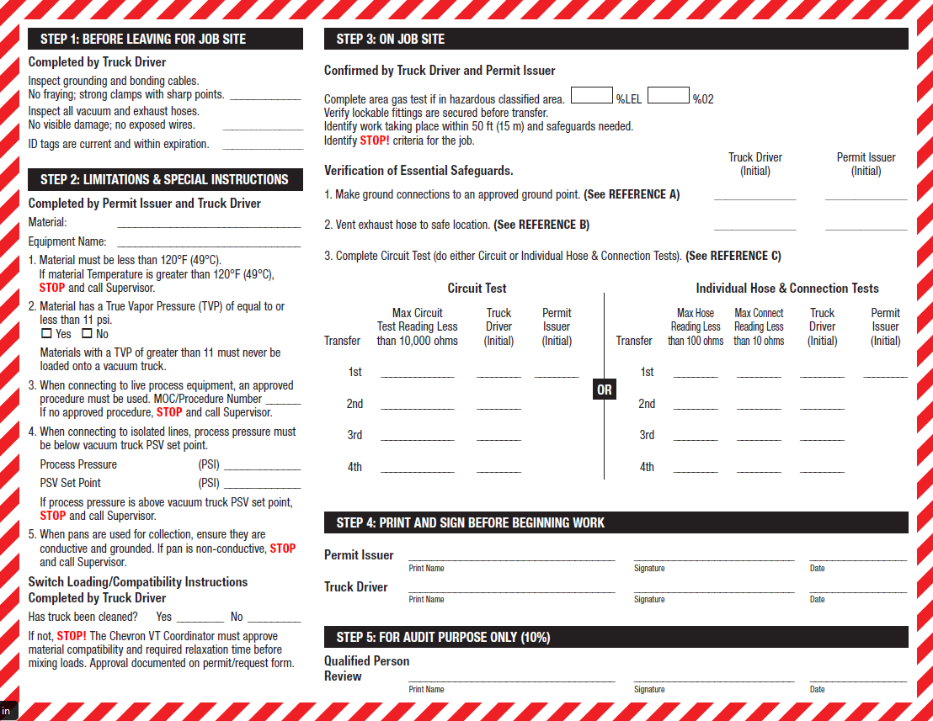
Vacuum Truck Service Request / Essentials Checklist
This must be completed before the equipment arrives at the location.
This Vacuum Truck Service Request / Essentials Checklist form and a General Work Permit must be completed for the following tasks:
Transferring gasoline or diesel product.
When the equipment (vac truck) is within a classified hazardous location.
When moving solids or dry material of any kind.
For multiple days, the form must be replaced daily.

Slide 9
Important Understandings
It is important to verify ground to earth for every job. Using the portable ground verification kit will accomplish this.
Understand how your Volt Ohm meter works. Ask your Supervisor or your local HES Specialist (TESH/RESH) if you are unsure.
The Essentials Checklist has a job aid to reference correct bonding and grounding resistance readings.
Vacuum Truck Equipment Requirements are listed on Appendix A.
Diagrams and pictures are available in the Appendices to show what a work site and connection structures should look like.

Slide 10
Vacuum Truck Safe Operation
The vacuum truck must be spotted on level ground safely away from flammable sources.
The vacuum exhaust hose routed a minimum of 50 feet (15 meters) away from personnel, and downwind from the truck and other ignition sources.
Trucks designed and equipped with vacuum vent stack exhausting at 12 feet (3.65 meters) above the truck’s cab are also acceptable (not approved by Chevron for still wind days).
Note: Properly spotting a vacuum truck away from flammable sources avoids potential ignition as well as “diesel runaway.” If runaway occurs or is suspected, shut down the truck’s engine immediately.

Slide 11
Vacuum Truck Safe Operation
Prior to each and every step –
assess, analyze and act.
Has the Ground to Earth been verified?
Has the equipment been properly inspected before brought on site?
Do all persons involved understand the task at hand and have protections/mitigations been verified and communicated?
If applicable, has the process equipment been properly isolated before work begins?

Slide 12
Prevent Injury
Know the hazards and dangers of the job to be done.
Plan your work activities. Remember to refer to the Preventing Serious Injury and Fatalities Field Guide when planning work.
Use LPSA and JLAs. What’s the worst thing that can happen? Mitigate or eliminate as many hazards as possible before starting work.
Reference: Safe Operation and Control of Vacuum Trucks (ESH 504)
Questions? Contact your local HES Specialist (TESH/RESH) or Safety Specialist.

