Slide 1
IOGP Start Work Checks
*IOGP = International Association of Oil & Gas Producers
Approved by Legal 9/14/23-muyk

Slide 2
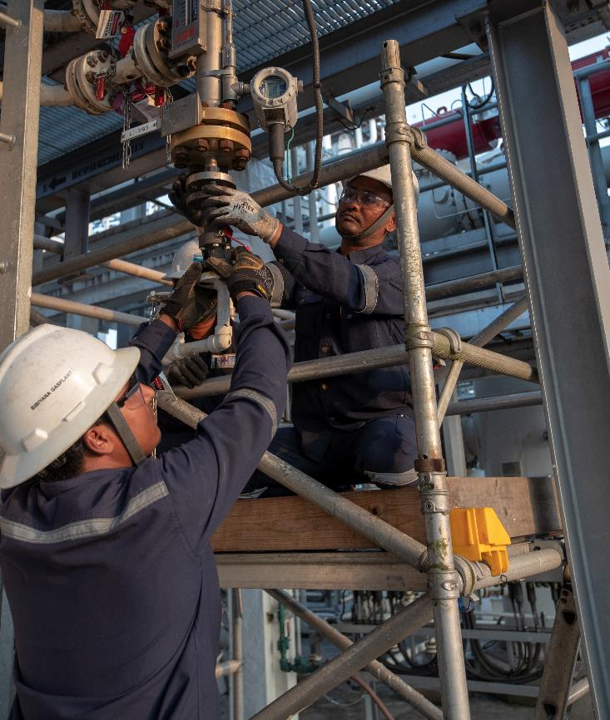
Why are we moving to IOGP Start Work Checks (SWC)?
Adopting an industry standard
Our current SWCs require the use of 2 separate documents to be effective: Start Work Check and Save Your Life Actions (SYLA)
Our Business Partners work with our peers as well – which in the past meant different processes and tools including SWCs.
One Simple Document
SYLA “How-to’s” included in the IOGP start work checks and fit on one page
Industry Standard Tool
Promotes consistent use for similar work across industry
80% Contracted Workforce
Alignment on lifesaving actions is critical to help prevent fatal outcomes
2
Approved by Legal 9/14/23-muyk
Notes:
Why move to adopting an industry standard tool?
Current State:
Our current SWCs requires the use of 2 documents to be effective:
The Start Work Check which is a list of Save Your Life Actions that must be put into place and verified.
The Save Your Life Actions (SYLA) document which expands upon the actions to give the workforce some “how-to”.
Our Business Partners work with our peers as well – which in the past meant different processes and tools including SWCs.
Future State:
The IOGP SWC has “how-to’s” built into the center column of the document which consolidates the tool into one easy to use document.
Adoption of the IOGP SWCs industry wide will provide clarity and alignment – leading to consistent use of the SWCs by contractors and operators doing similar work across the industry.​
For an industry with an ~80% contracted workforce, alignment on lifesaving actions is critical to help prevent fatal outcomes.

Slide 3
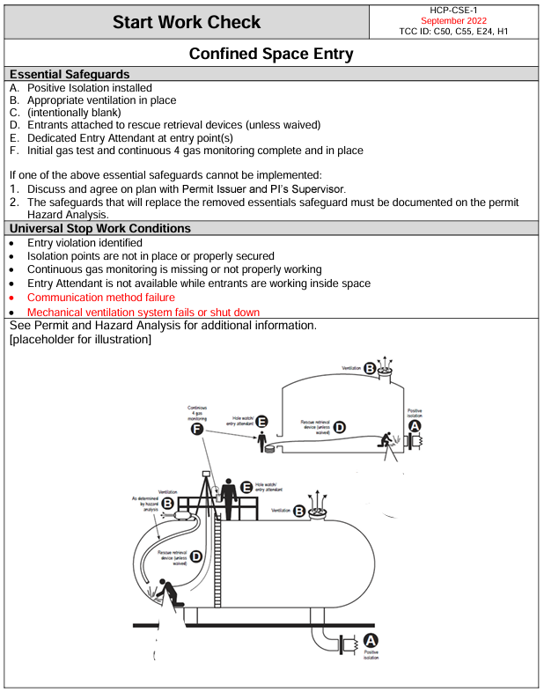
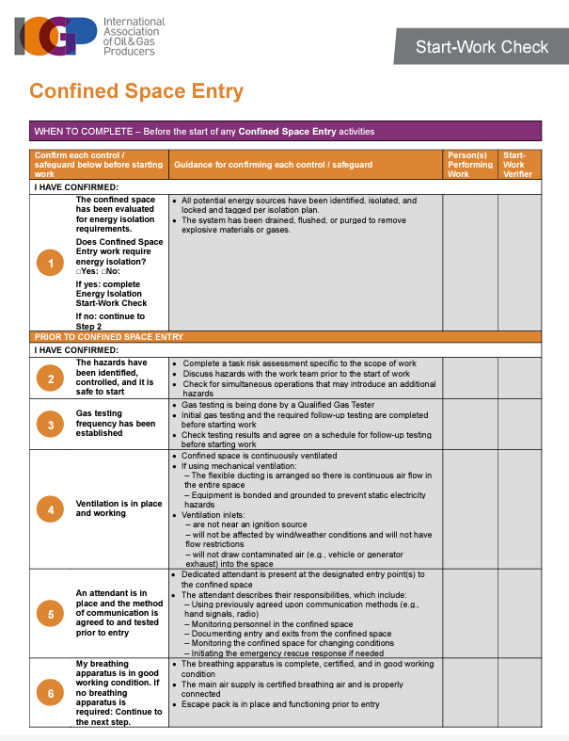
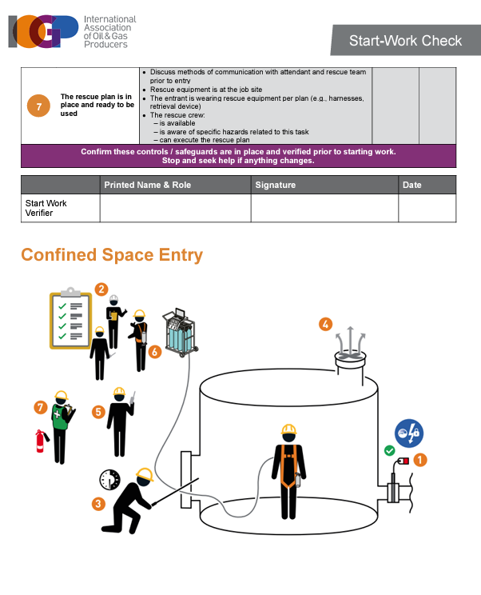
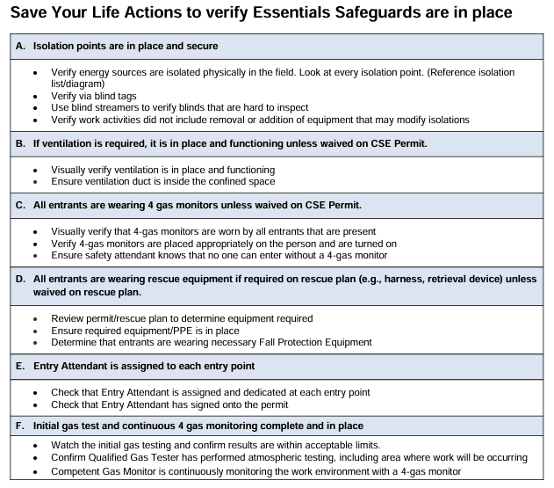
CoW/IOGP Start Work Checks
Confined Space Entry SWC - what are the changes?

Slide 4
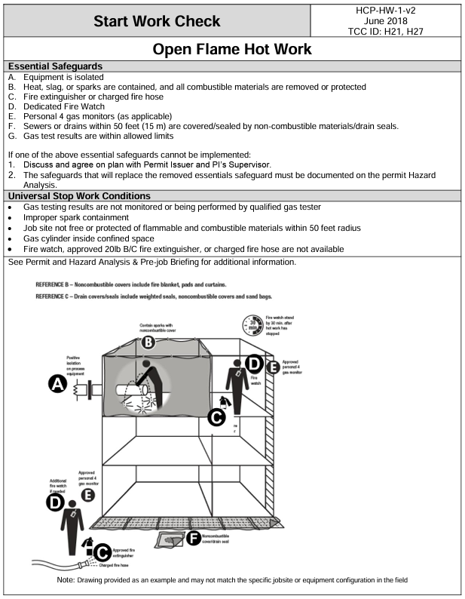
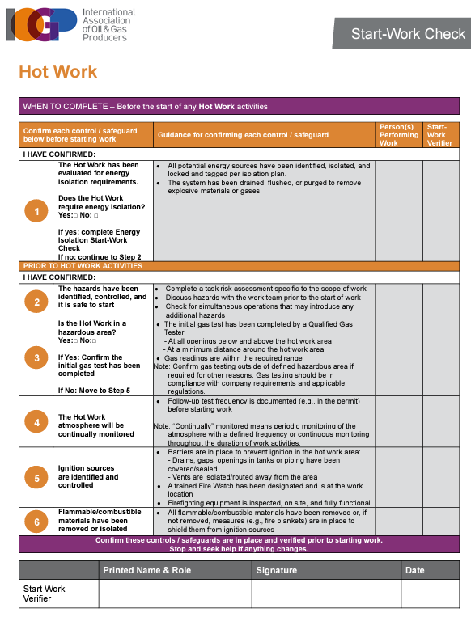
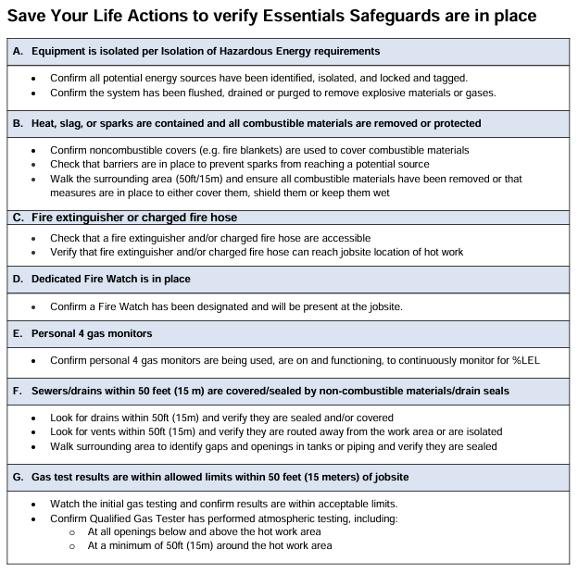
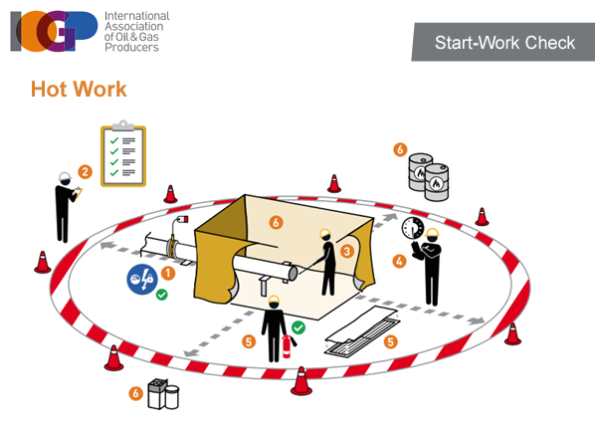
CoW/IOGP Start Work Checks
Hot Work SWC - what are the changes?

Slide 5
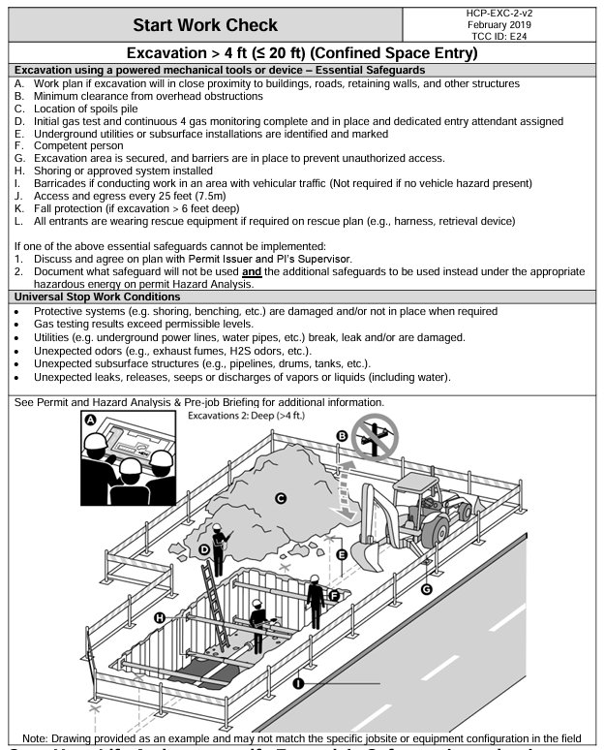
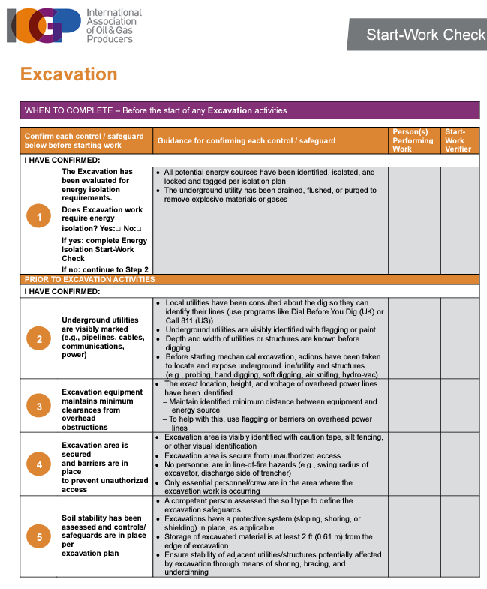
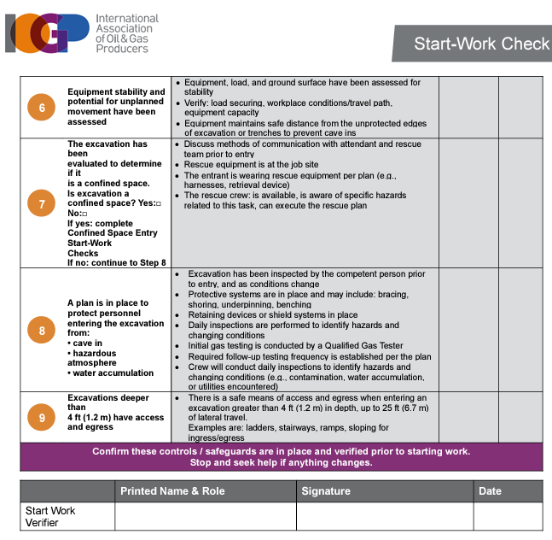
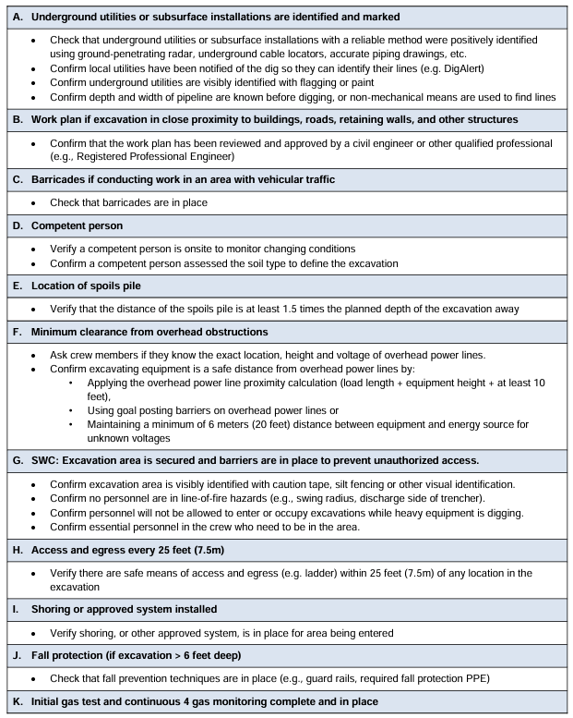
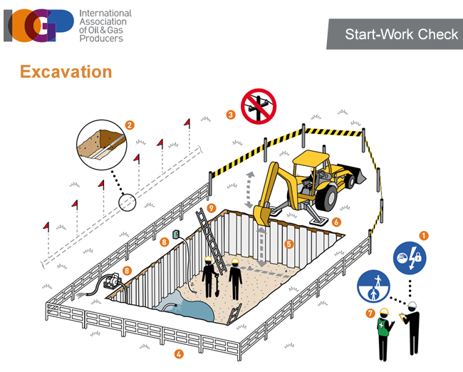
CoW/IOGP Start Work Checks
Excavation SWC - what are the changes?

Slide 6
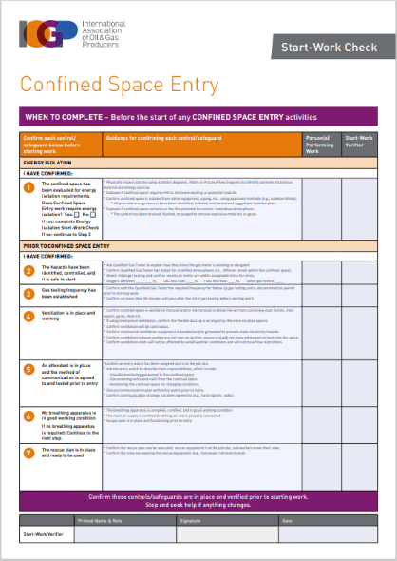
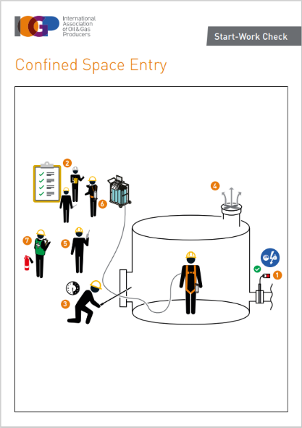
IOGP Start Work Checks
Confined Space Entry Energy Isolation De-Isolation and Re-Energization Excavation Open Flame Hot Work Mechanical Lifting | Energized/Live Electrical Systems Working at Height Driving - New Work Near Water - New Work Around Mobile Equipment - New Man-riding – N/A Rig Floor Tubular Handling – N/A
Total of 13
Notes:
For workers familiar with Chevron’s Start Work Checks, point out minor name changes as we transition to the IOGP Start Work Checks:
- Chevron’s “Isolation of Hazardous Energy” is now IOGP’s “Energy Isolation”
Chevron’s “De-Isolation of Hazardous Energy” is now IOGP’s “De-Isolation and Re-Energization”
Chevron’s “Hot Work” is now IOGP’s “Open Flame Hot Work”
Chevron’s “Lifting and Rigging” is now IOGP’s “Mechanical Lifting”
Chevron’s “Energized/Live Electrical Work” is now IOGP’s “Energized/Live Electrical Systems”

Slide 7
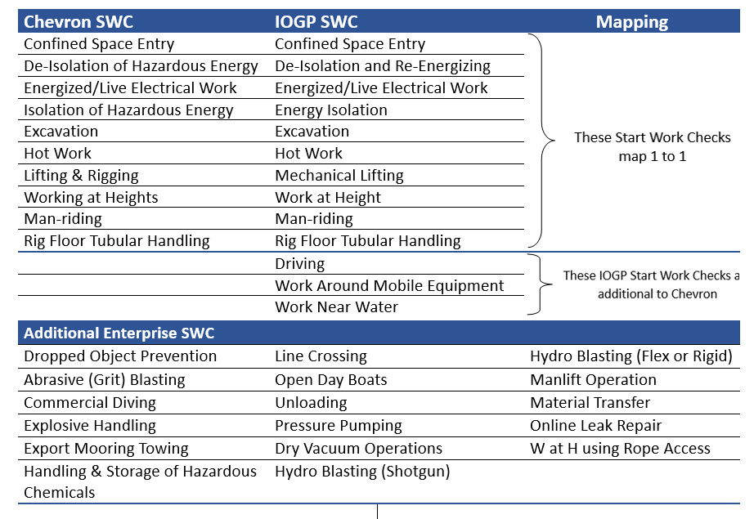
How Chevron’s start work checks map to IOGP’s

Slide 8
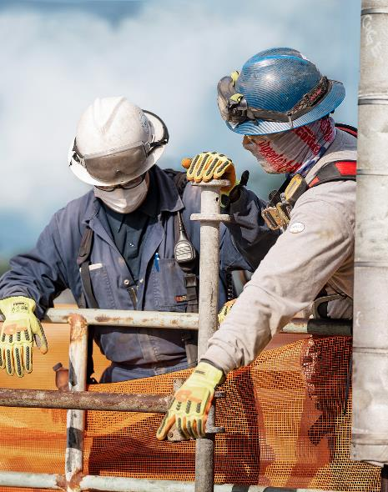
Where and when should a Start Work Check be completed?
The SWCs create an opportunity for the work crew to walk through and talk through the task to be performed. To be effective, this should be done where the plant or equipment is located, just prior to starting all SIF Potential Work (i.e., where the task is carried out, with the tools and equipment about to be used/worked on).
Also, the SWCs can be used:
Anytime the jobsite is left unattended, e.g., after a work break, or for any other reason
After a shift change
If work extends beyond a single shift
If the work crew changes
If there is a change in personnel within the work crew
When requested by frontline supervisors
To reinforce stop work authority if any of the work team have concerns over the status of the controls/safeguards during the task.

Slide 9
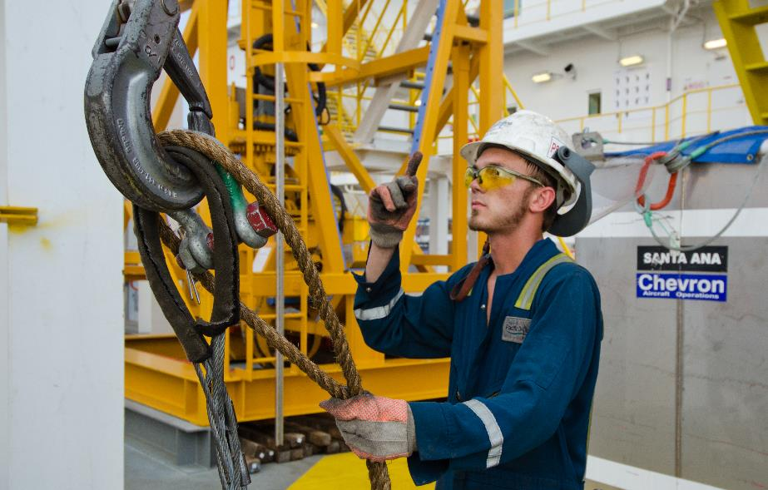
Start Work Check Requirements
All SWC’s that apply to the task should be used, whether a Permit to Work is required or not, they are required for all SIF Potential Work.
To enable work crews to implement SWCs, the Checks should be made available in an easily useable format such as:
paper copies
an erasable hard copy format
electronic formats, (e.g., mobile device app)
or a combination of these.
The most current version of the SWC is retained at the worksite until completion of the task
Completed wet ink SWC documents shall be retained as per BUs retention guidelines.

Slide 10

How to complete the IOGP Start Work Check
Worker and Verifier both complete the checks.
Everyone on crew should be involved in verifying safeguards, but only one person needs to check off as crew representative
Visually/physically verify each safeguard is in place and functioning
Full page diagrams to aid understanding
Worker:
Member(s) of the specific work crew (or a lone worker) who is about to do the task
Verifier:
Permit Issuer
Center section is guidance only and provides examples of how to confirm numbered safeguards if someone is not sure
Final row completed by the verifier once all check
items verified
John Smith, HO
John Smith
9/1/23
The checks could be a check mark or initials
Notes:
According to the workforce, the SYLA document was not being utilized to its full potential. This is why IOGP went to a single document format.
The Checks have three human performance aspects as part of their design:
Place keeping (by marking each step as complete)
Peer review (the Verifier role)
Stop and seek help

Slide 11

Who performs the work and what is their role?
Who Performs | Member(s) of the specific work crew (or a lone worker) who is about to do the task the Start Work Check is relevant for
Worker Role | The person performing work confirms the SWC prior to starting work. If the control/safeguard cannot be confirmed and verified (by a designated verifier) the worker should stop and ask for help before starting the task. In addition, they should: Know the requirements of the SWC Confirm that the identified controls/safeguards are in place and functioning prior to starting the task. This requires: Having the SWC form available during confirmation Physical confirmation that each control/safeguard is in place Marking (e.g., by initialing) the form to indicate each control/safeguard on the Start Work Check has been confirmed. Stop when a check cannot be confirmed and know who to contact for help if a control/safeguard cannot be confirmed Inform the crew supervisor when SWC requirements are complete Wait to start work until all controls/safeguards are verified by the assigned Verifier

Slide 12

Who is the Verifier and what is their role?
Who Performs | Someone other than the worker confirming the SWC steps, who is an experienced person familiar with the activity, and performs a peer-review of the Start Work Check If a Permit to Work (PTW) is required, the verifier should not be the permit holder. The verifier role does not replace the accountability of a permit holder or person in charge.
Verifier Role | The verifier plays an essential role in confirming all SWC controls/safeguards are in place and functioning after the person(s) performing the work has completed their confirmations. The intent of the Start Work Checks is for the verification to function as a peer review. The verifier role should be performed by someone other than the worker confirming the SWC steps. The role of the verifier adds an additional layer of assurance for controls/safeguards that prevent fatalities and serious injuries.

Slide 13
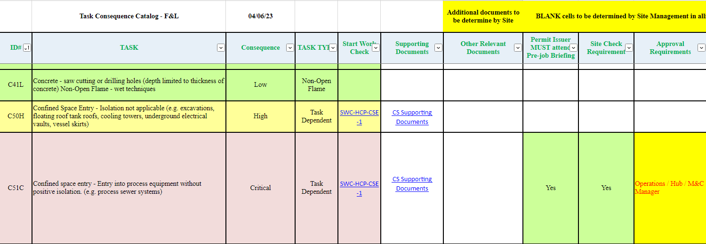
How do we know when a SWC is required
Hyper Links included to applicable SWC

Slide 14
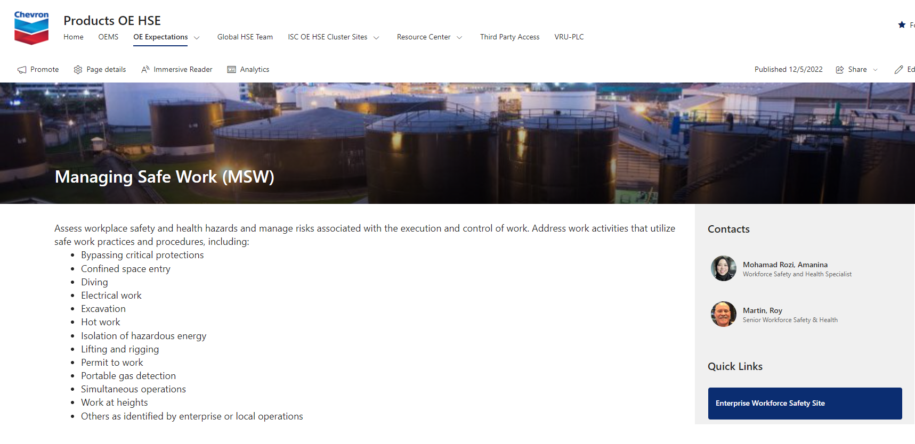
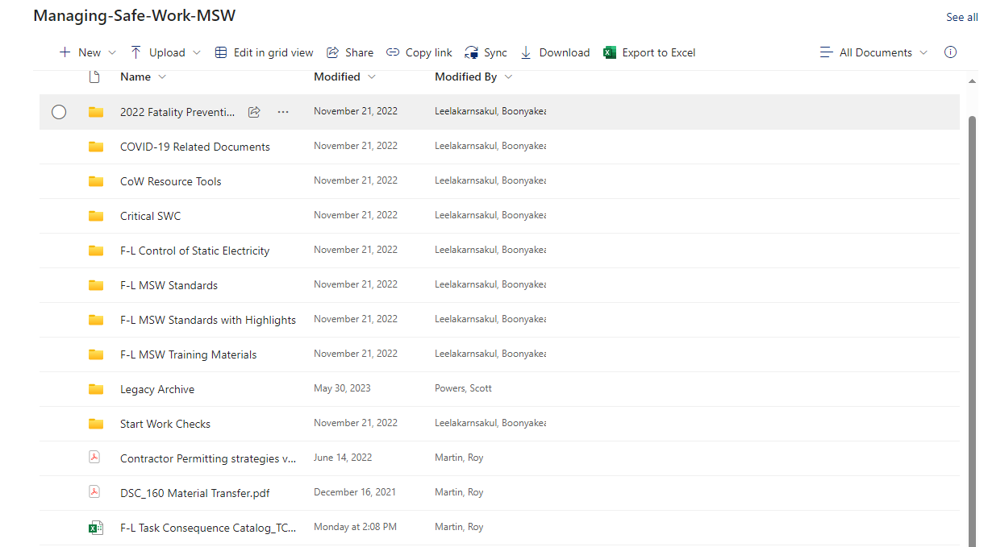
Where to find the Task Consequence Category (TCC)
From Products OE HSE SharePoint, click OE Expectations – Managing Safe Work
Click on link to access TCC

