Slide 1
MSW Initial/Refresher Training:
Hot Work and Gas Detection

Slide 2
Key Definitions from Hot Work Standard
Common Definitions
Competent Person
  A person with the knowledge & experience to be able to meet all company and legislative expectations in respect of the task being performed
Confined Space
      A person can bodily enter the space and perform assigned work;
      The space has limited means of entry and exit;
      The space is not designed for continuous occupancy; and
      The space contains (or has contained or has the potential to contain) a hazardous atmosphere.
Hazardous Area
– Any classified hazardous area and/or those areas of a facility where flammable liquids, gases or vapors are present on a continual, intermittent or periodic basis and/or where flammable liquids, gases or vapors may be present but are confined within closed containers or systems under normal operating conditions.

Slide 3
Key Definitions from Hot Work Standard
Common Definitions
  Hazardous Atmosphere
  – Atmosphere (s) that expose personnel to the risk of death, incapacitation, impaired ability to self-rescue, injury, or acute or chronic illness that may be caused by any of the following:
    An atmospheric concentration of any substance that could result in personnel exposure in excess of the permissible exposure limit (PEL), such as benzene or hydrogen sulfide.
    Flammable gas, vapor or mist in excess of 10 percent of its lower flammable limit (LFL).
    An atmospheric oxygen concentration less than 19.5% or more than 23.5%.
    Any other atmospheric condition that is immediately dangerous to life or health (IDLH).
Gas Testing
    Use of portable detection equipment to determine levels of oxygen and flammable or toxic vapors and gases.
  Continuous Gas Testing
  - A process whereby the required gas tests are continuously monitored. Continuous gas testing is normally required where there is a high likelihood of changing gas concentrations and/or there is a high risk to workers if the gas concentration changes unexpectedly.
  Follow Up Testing
  - Testing performed after initial testing at intervals sufficient to ensure that the atmosphere remains safe for the work being performed. Follow-up tests must be performed whenever work has been stopped and unattended for more than 1 hour.

Slide 4
Key Definitions from Hot Work Standard
Types of Hot Work
Hot work is any activity that involves a source of ignition, or where sufficient heat may be generated to ignite flammable or combustible materials.
This includes (but is not limited to) any type of open flame (e.g., torches, etc), arc welding, arc gouging, grinding, sand blasting or high-pressure water jetting, use of electrical tools, Battery powered instruments that are not intrinsically safe and use of any tools, etc. that can produce heat sufficient to be an ignition source.
Hot Work – Open Flame
  This type of ignition source constitutes the highest risk of ignition in our industry. Open flames and known incentive spark producers are usually associated with the following activities: welding, cutting, grinding, burning, brazing, matches, lighters, smoking, etc.
Hot Work – Non-Open Flame
  This ignition source type generally involves ignition energy associated with electrical powered tools and equipment. It also includes hot surfaces and tools with rotary motors that can produce sparks. The following are some examples: vehicles, generators, welding machines, portable electrically powered tools, lab analyzers, power tools with rotary motors, unclassified electrical equipment, laptop computers, etc.

Slide 5
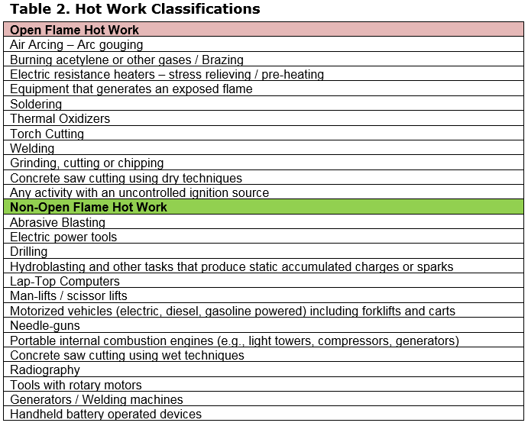
Types of Hot Work
Examples of Hot Work from Hot Work Standard
Many flammable products handled at facilities do not require an open flame or spark to ignite them.
For such products, any energy source that creates sufficient temperature can ignite a fuel/air mixture which is within the flammable range.
If temperatures reach a fuel sources auto-ignition temperature it can ignite (e.g. a hot engine exhaust, an electrical element creating high temperature, or a piece of hot steel).
Some typical auto-ignition temperature of our common products are:
  Gasoline 390°C (734°F)
  Diesel 350°C (662°F)
  Kerosene 380°C (716°F)
(note – auto-ignition temperature will vary and typically will cover a range of temperatures)
Auto-ignition
Examples of Open Flame and Non-Open Flame Hot Work that could be conducted in a facility.

Slide 6
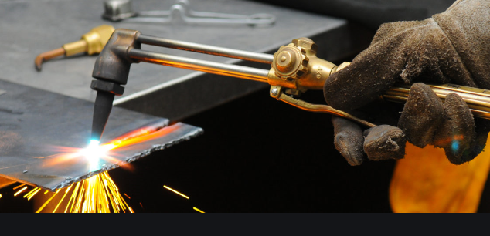

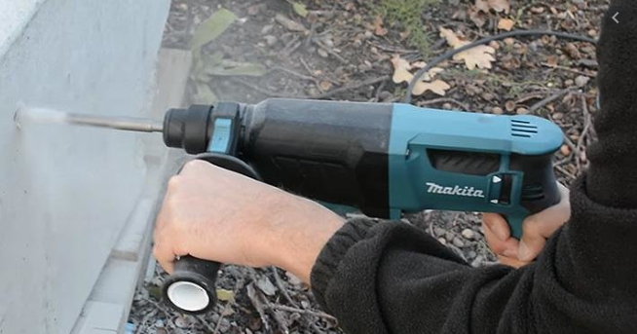
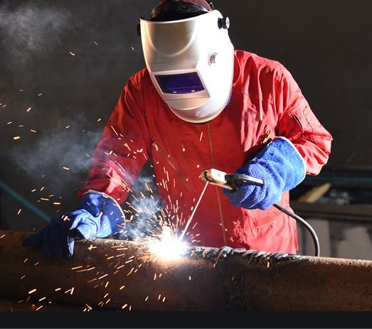
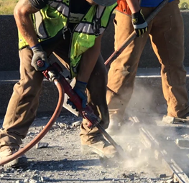
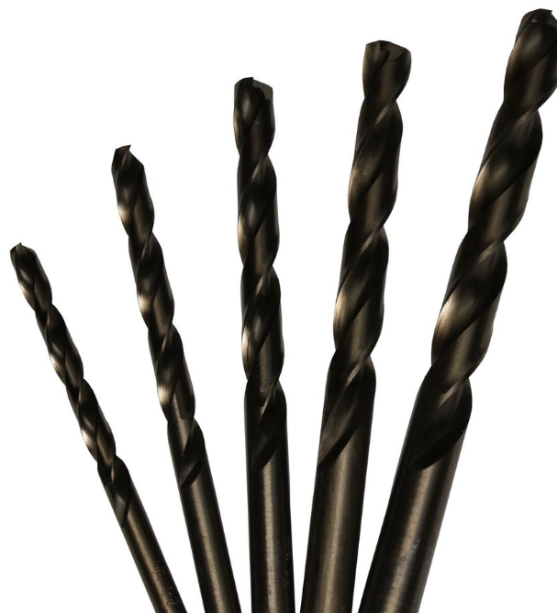


Types of Hot Work
Open Flame Hot Work
Classic Open Flame Hot Work
Non-Typical Open Flame Hot Work
Open flame vs. non open flame depends on the output of the tool used.
Sparks/flame = Open Flame
No spark/flame = Non-Open Flame
Depending on what bit is used the same tool can be used for open flame or non open flame hot work.
Gas cutting
Concrete drilling
Welding
Concrete breaking with Jackhammer
Grinding/Cutting
Notes:
Non-typical open flame hot work – the categorization of the OF Hot Work activities will also depend on the area where the work is conducted. The same activity may fall as NOF Hot Work in the area where there is no presence of flammable gas while will become an OF Hot Work within the area where there is presence of flammable gas.

Slide 7
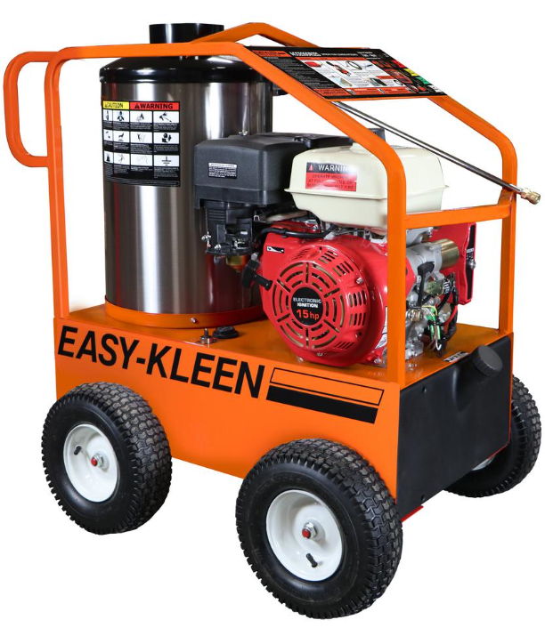
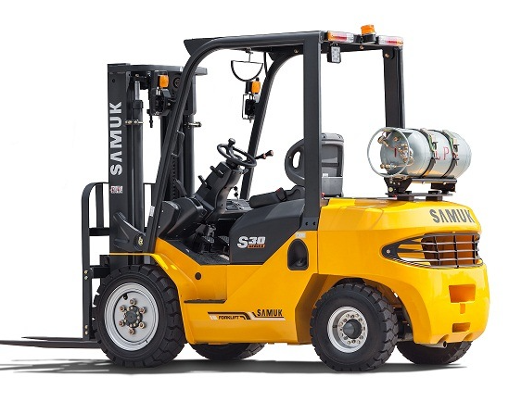

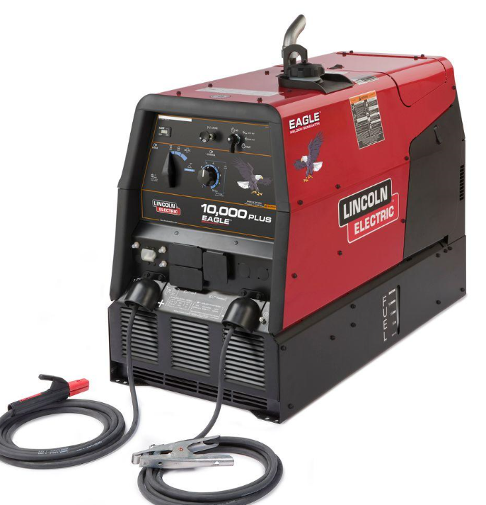
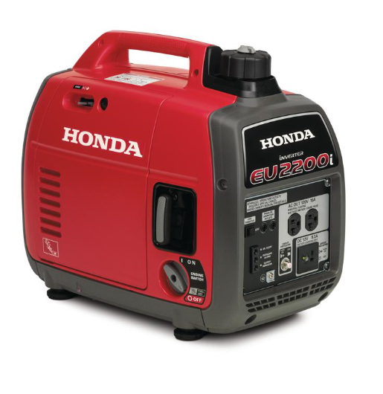
Types of Hot Work
Non-Open Flame Hot Work
Fueled Equipment =
Non-Open Flame Hot Work
Portable Cordless Tools =
Non-Open Flame Hot Work
Forklift
Motorised pumps
Cordless tools still considered as hot work (non-open flame) when used in areas where flammable vapors are likely to be present (classified areas)
Generators

Slide 8
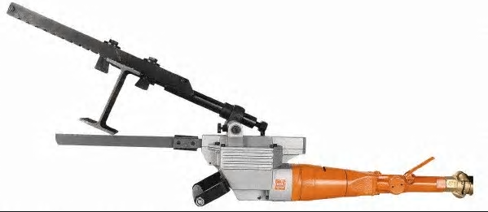
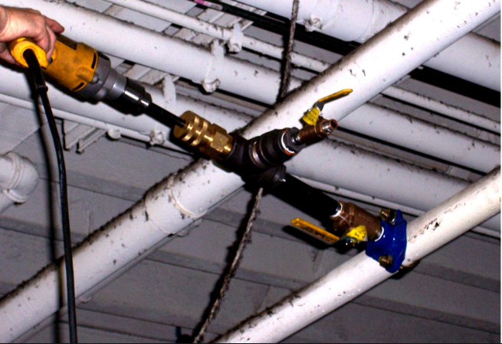
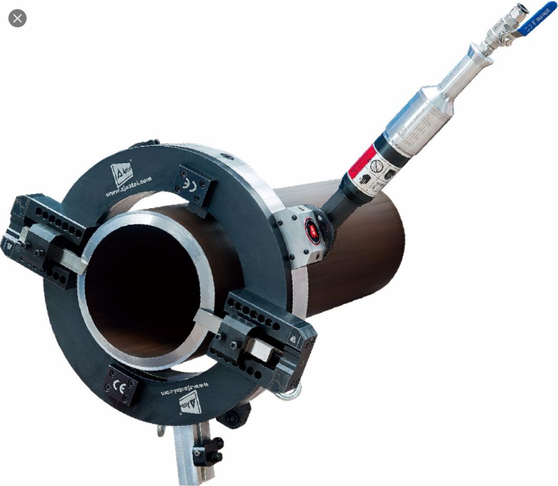
Non-Hot Work Tools
Non spark producing air tools are not considered hot work – even in classified areas. They are typically operated with low speed.

Slide 9
Hot Work
Hazards and Alternatives
Hot Work – Hazards and Consequences
  Hot Work is a hazardous activity. Explosions and fires have occurred in Chevron from hot work.
    Hot Work on a tank that didn’t have adequate safeguards caused an explosion in the tank, causing the roof of the tank to fly off and land 50 meters away.
    Explosions have occurred in F&L operations during truck loading.
  It is critical that we all follow the requirements of the Hot Work Standard whenever we are conducting this type of task.
Hot Work Alternatives
Cold work or other alternatives shall be considered before undertaking hot work. These alternatives include, but are not limited to:
Use of hand or pneumatic tools that have a low probability of creating enough energy to ignite a flammable mixture.
Movement of the material outside of classified areas.
Mechanical bolting or other non-hot work alternatives
Delaying work until next scheduled shutdown
Hot work shall not be permitted in the presence of explosive atmospheres.
Opening Piping & Equipment that may contain flammable materials shall not be done using Open Flame or Non-Open Flame Hot Work techniques unless it has been verified to be free of flammable materials prior to opening.
Hot Work may not be conducted within 50 ft (15m) when Opening Piping & Equipment that may contain flammable materials until the piping or equipment has been verified to be free of flammable materials prior to opening or
Notes:
One of the best alternatives available is to do most or all hot work in the fab shop
Use the hierarchy of controls
30 MIN

Slide 10
Hot Work
Work Authorization Requirements (Permit to Work)
Hot Work Permit
  The Hot Work Permit is used to authorize Hot Work to be performed and aids in assuring that key safeguards are in place prior to the work being conducted. The Hot Work Permit only authorizes the Hot Work portion of the task(s) being conducted. The General Work Permit and (as required) other Permits/Forms will be used to manage the job as a whole.
  Requirements for a Hot Work Permit are as follows (not limited to):
    Open flame hot work inside a hazardous (Classified) location shall require a hot work permit.
    Non-open flame hot work inside a hazardous (classified) location shall be permitted in accordance with risk as determined by the site.
    The use of handheld, battery-operated devices shall be permitted in accordance with risk as determined by the site.
  A Hot Work Permit shall not be required for Open Flame Hot Work inside a designated Safe Hot Work Area.

Slide 11
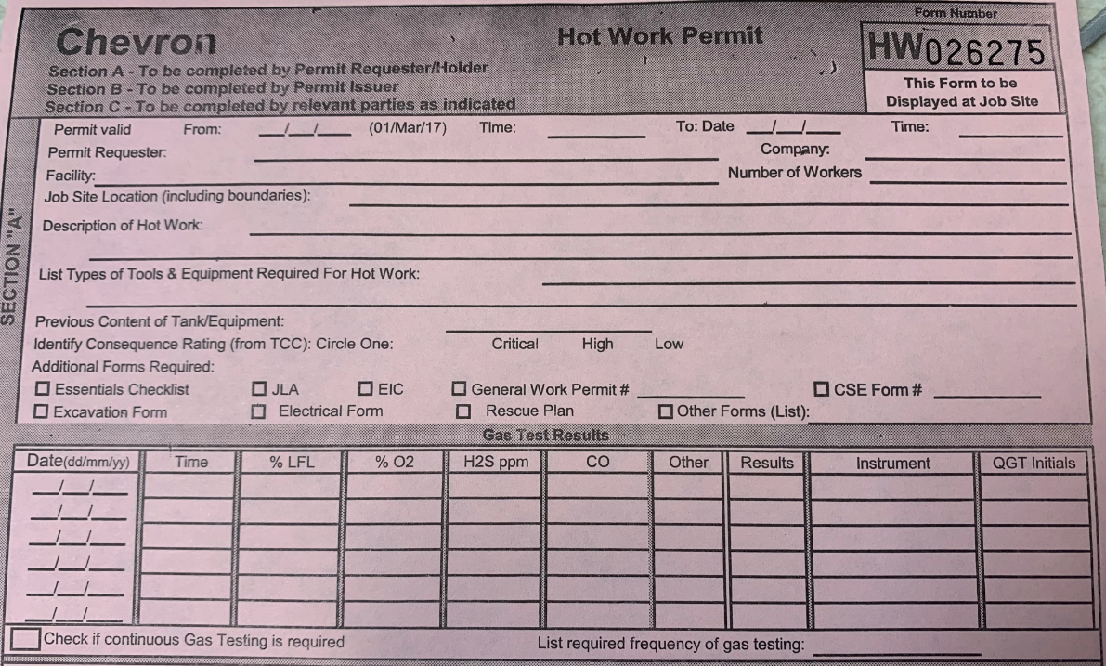
Hot Work
Work Authorization Requirements (Permit to Work)
The Hot Work Permit is made up of three sections
    Section A - Completed by Requester and submitted with a Permit to Work
    Section B - Completed by Issuer & Holder.
    Section C - Signatures of designated parties as required
Depending on the nature of the hot work taking place – additional forms may be required.
  Equipment Isolations Checklist (EIC)
  Confined Space Entry Permit
  Excavation form
  Other forms as designated by Permit Issuer.

Slide 12
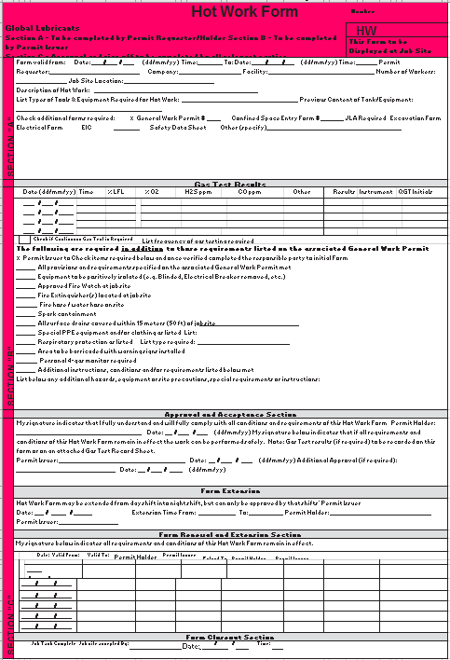
Hot Work
Work Authorization Requirements (Permit to Work)
Hot Work Permit
  A Hot Work Permit is required for:
    All Open Flame Hot Work and
    All Open Flame and Non-Open Flame Hot Work in Classified Areas.
  A Hot Work Permit must always be accompanied by a General Work Permit.
  Hot Work Form is typically recognized by it’s Pink Color.
  Once agreement has been reached and required safeguards are in place and verified, the Permit Holder will sign the General Work Permit and the Hot Work Permit. In addition to indicating that the safeguards are in place, the Permit Holder signature indicates that the requirements are understood and that the work crew will comply with them.
  When all the workers, Permit Holder and Permit Approver (if required) signatures are in place, and the Permit Issuer is satisfied that all safeguards have been identified and are in place, the Permit Issuer can sign the permits, thereby giving approval for the work to begin.

Slide 13
Hot Work
Work Authorization - Permit Issuance, Extension and Renewal
Permit Issuance
  Work must start within an agreed time period, as designated by the Permit Issuer, when the permit is issued. If work does not start within the designated time frame, then the work permit must be revalidated.
  In all cases, if the work does not start within 1 hour of the issue time listed on the Hot Work Permit, the permit must be revalidated. Revalidations must be documented per the Permit to Work Standard.
Permit Extension
An Extensions of permits must be documented in Section C of the permit(s). The Permit Issuer must confirm in the field that all conditions, requirements and controls of the Hot Work Permit, General Work Permit, related Permits/Forms, and the JSA remain in effect.
Permit Renewal
Before a Hot Work Form may be renewed the Permit Issuer must confirm the following:
  A valid General Work Permit is in place.
  Confirm in the field that all conditions, requirements and controls listed on the Permit and JSA remain in effect.
  Confirm that the scope of work remains the same.
  The approved Fire Watch is assigned and present in hot work area.
  Required fire-fighting equipment is on hand and in good operating condition.
  Complete the required documents as indicated by TCC

Slide 14
Hot Work
Work Authorization - Permit Renewal, Revalidation and Changes
Permit Renewal
Before a Hot Work Form may be renewed the Permit Issuer must confirm the following (continued):
    The responsible Qualified Gas Tester (Chevron) must perform new gas testing and document the results. Gas test results must be within an acceptable range (zero percent LFL).
    Obtain the signatures of the Permit Holder in the renewal section.
    Update all copies of the General Work Permit and any other permits/forms required.
    All personnel must sign the renewed General Work Permit (or attached form) following the pre-job safety meeting
Permit Revalidation
Should site conditions change or the work be stopped for a period over 60 minutes with no one in attendance, the General Work Permit and Hot Work Form must be revalidated before work can be restarted. Revalidation requires the Permit Issuer to verify that all conditions and requirements on the permit and form remain in effect. The work may be resumed only after the Permit Issuer has given approval to restart the permitted work.
  Permit revalidation must include gas testing to assure zero % LFL
Changes to the Permit
  Only the Permit Issuer can make changes to the information on the permits and associated forms, and any changes made must be documented on all copies and communicated to the Permit Holder.

Slide 15
Hot Work
Work Authorization - Permit Suspension and Cancellation
Suspending a permit
  Hot Work shall be stopped / suspended and all ignition sources eliminated, and the Permit revalidated prior to resumption of work, in but not limited to the following circumstances:
    Change in job site conditions that may create a potentially minor unsafe condition
    Gas monitoring indicates concentrations outside of the accepted values.
    The Facility emergency alarm is sounded excluding planned or routine testing.
    A required safeguard is no longer present or functional (examples: gas detection failure, etc.)
    Anyone exercises Stop Work Authority
    Change in scope of the work that was not anticipated
    The job site has been unattended for more than 1 hour
Permit Cancellation
Work must be stopped, and the permit canceled under any of the following conditions:
    No qualified Fire Watch designated for the hot work or the fire watch gets called away
    A change in the scope of the work (such as the addition of work that was not originally anticipated e.g., cold work task requiring hot work methods, task changes making entry into a confined space necessary, etc.)
    A change in the job site conditions, resulting in a potential significant hazard, such as a leak or spill.
    The permit limit has been reached. The permit can only be open for seven calendar days.
    There’s been an interruption of work due to a holiday, vacation, and/or any other interruption (excluding the two weekend days which are allowed) of a day or more.
    The entire work crew has changed.
After Cancellation, a new permit must be issued to resume work.

Slide 16
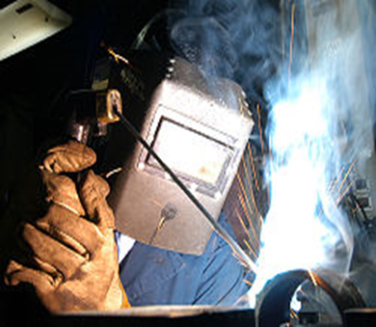
Hot Work
Roles and Responsibilities
Fire Watch
  An individual who is trained and competent in basic fire-fighting and whose role it is to observe conditions in the immediate and adjacent areas of hot work to ensure it is performed safely, and to sound the alarm if necessary.
Person Performing Hot Work
  Knows how to perform the Hot work procedures and is aware of the hazards involved.
  Only performs hot work when the requisite work permits are in place.
  Inspects all equipment required for the task.
  Stops the work if unsafe conditions develop.

Slide 17
Hot Work
Roles and Responsibilities
Qualified Gas Tester
  A person who has received thorough training in gas-testing above the Competent Gas Monitor level. This person is more knowledgeable in what gases are likely to be present in process areas and understands gas testing techniques to a deeper level. A Qualified Gas Tester must be a Chevron employee and have passed the relevant SWP standards training.
Competent Gas Monitor
  A person who is competent in the calibration and use of portable gas-testing equipment and has successfully demonstrated the use of the equipment in the field and is able to recognize hazards inherent to Hot Work or Confined Space Entry.
  A Competent Gas Monitor can be an employee or contractor.
Notes:
*****Remember

Slide 18
Job Site Preparation for a Hot Work
Hazard Analysis
Hazard Analysis
  A Hazard Analysis shall be performed in accordance with the F&L Hazard Analysis Standard when planning work involving Hot Work:
    To identify significant potential hazards.
    To identify the need for safeguards such as gas testing.
    To identify if work will require permits (e.g., Permit to Work, Isolation of Hazardous Energy, Confined Space & Excavation).
    To assess the need for or evaluation of Simultaneous Operations (SimOps).
    To identify and evaluate precautions to ensure that work may be conducted safely.
  Planning Phase Hazard Analysis
    Qualified person(s) carry out a hazard assessment as early as possible to identify potential hazards and determine controls.
  Additional Forms and Documentation
    Based on the Hazard Assessment the requirement for additional work forms will be determined. (e.g. Critical Start Work Checks Form, Confined Space Entry form)

Slide 19
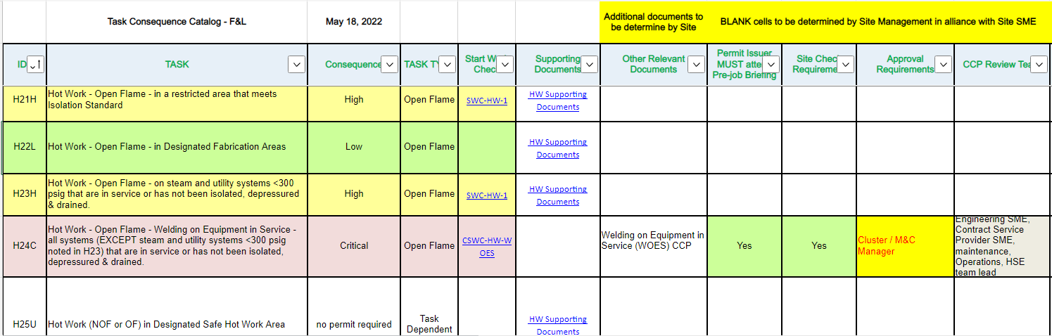
Job Site Preparation for a Hot Work
Hazard Analysis
Hazard Analysis
  All work tasks require a review of the Task Consequence Catalogue (TCC) to help with determining what Hazard Analysis, Permit(s), Approver, etc. requirements are necessary. The TCC is part of the Hazard Analysis Standard.

Slide 20
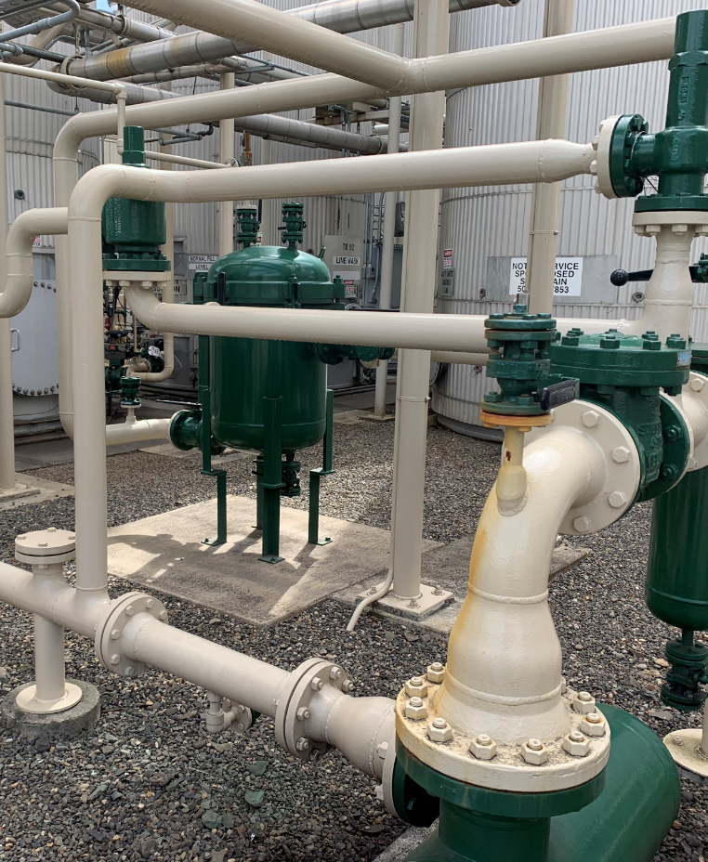
Job Site Preparation for a Hot Work
Preparation of Job Site/Equipment
  Isolate per the F&L Isolation of Hazardous Energy Standard which includes de-pressuring, purging, flushing, cleaning, draining and venting tanks, piping and equipment as appropriate
    DO NOT ISSUE A HOT WORK PERMIT FOR A JOB SITE PRIOR TO BREAKING OPEN LINES!!
      Opening lines can expose vapors
      Positive physical isolation is required when hot work is planned on lines, tanks, vessels, etc.
      Gas Testing need to be done prior start up.

Slide 21
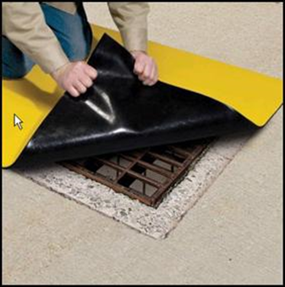
Job Site Preparation for a Hot Work
Preparation of Job Site/Equipment
  Flammable and Combustible materials shall be removed or otherwise protected within a 50 foot (15 meter) radius for Open Flame Hot Work.
  Floor openings, holes, ducts or cracks in flooring or walls, open doorways and open or broken windows that cannot be closed or removed and may be exposed to sparks shall be protected within a 50 foot (15 meter) radius.
  Sealing drains within 50 feet (15 meters) of the hot work
  Floor openings, holes, ducts or cracks in flooring or walls, open doorways and open or broken windows that cannot be closed or removed and may be exposed to sparks shall be protected within a 50 foot (15 meter) radius.

Slide 22
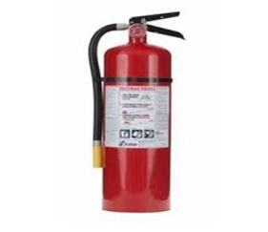
Job Site Preparation for a Hot Work
Preparation of Job Site/Equipment
  Gas cylinders for hot work shall not be taken into confined spaces. When not in use, gas cylinder valves shall be closed. Always remove torch leads when not in use and when unoccupied.
  Make sure fire-fighting equipment is in position and in good condition
  Notifying facility personnel.
  Ensuring there is a designated Fire Watch person at job the site.
  Gas-testing the job site and the surrounding 50 feet (15 meters).

Slide 23
Job Site Preparation for a Hot Work
Fire Watch
A Qualified Fire-Watch must: Be established and present for all open flame hot work in Hazardous (Classified) areas and for open flame hot work in non-Hazardous (Classified) areas when there is a potential for more than a minor fire (incipient stage fire).
  Must have knowledge of work planned, hazards involved, how to sound alarm in event of emergency and requirements of emergency evacuation plan/routes
  Must have training in Incipient Stage Fire Fighting
  Must have minimum of one (1) fire extinguisher or charged fire hose available in hot work area
    Extinguisher must have evidence of servicing within past year
    Extinguisher cannot be plant area assigned extinguisher
    Extinguisher must be appropriate for class of potential fire
    Extinguisher must be 9 kg (20 lb) minimum
  Fire Watch must be maintained for thirty (30) minutes minimum after Open Flame Hot Work has stopped (including breaks) to inspect and observe for any signs of smoldering fires and possible combustion.

Slide 24
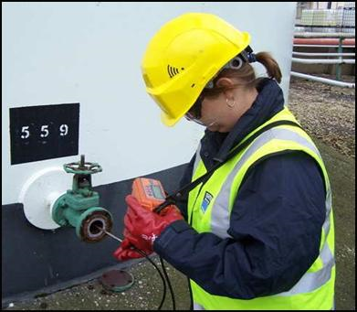
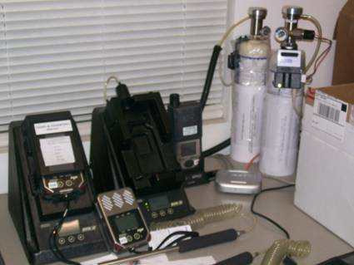
Job Site Preparation for a Hot Work
Gas Testing
Gas Testing
Gas testing is required prior to all hot work in classified hazardous areas and prior to Open-Flame hot work in all areas. In addition, periodic testing or continuous testing is required as detailed in the following slides.
.
Notes:
Question – Do we need gas testing for non open flame hot work in a non classified area.
3 PM

Slide 25
Job Site Preparation for a Hot Work
Gas Testing
Initial Gas Testing
  Initial gas testing shall include testing for oxygen and flammable vapor, and other toxic gases and vapors as identified in the hazard assessment. The results of such a test will be used to determine:
    If the area is safe for hot work
    If additional vessel or equipment purging is necessary
  Initial and follow up (revalidation) gas testing must be performed by a Qualified Gas Tester. Monitoring gas detection equipment can be done by a Competent Gas Monitor.
  Initial testing must be performed after the piping and equipment have been properly isolated and prepared and BEFORE the hot work permit is issued.
  Gas testing for LFL shall be performed in the surrounding area for a distance of 50 feet (15 meters). Hot work must not be performed if LFL is greater than zero percent and/or if combustible liquids/gasses are present. The exception is hot tapping for which specific precautions must be taken (see the Task Consequence Catalogue).
  If gas test results indicate greater than zero percent LFL, the source of the flammable gas or vapor must be identified and actions taken to eliminate it.
Notes:
gas testing must be AFTER isolation and BEFORE hot work permit issued and within 50 ft radius

Slide 26
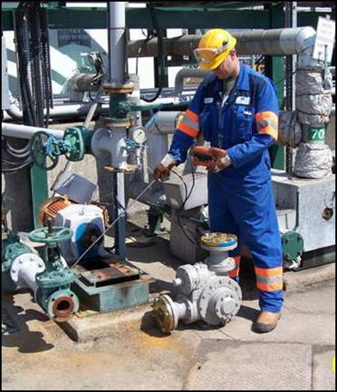
Job Site Preparation for a Hot Work
Gas Testing
Continuous Gas Monitoring
  Continuous Gas Monitoring is where the portable gas testing equipment is left running in the vicinity of the work to be done, for the duration of the work to be done.
  Continuous Gas Monitoring is required for the following:
    Where flammable vapors could be introduced due to changing conditions. This is based on the physical environment and history of incidents in Chevron or similar industries.
    Hot Work in Confined Spaces
    Hot Work in Excavations where there is a possibility of the soil contaminated with hydrocarbons or other potentially flammable substance
    In a Classified Area (both Open Flame and Non-Open Flame)
Continuous Gas Monitoring may be done by a Competent Gas Monitor or a Qualified Gas Tester.
Follow-up Gas Testing
  The Qualified Gas Tester will determine the frequency of gas testing based on the potential risk, but in no cases shall followup gas testing exceed 4 hours or the work must stop and the Permit(s) must be revalidated. The required frequency of gas testing must be noted on the work permit documents.

Slide 27
Job Site Preparation for a Hot Work
Building OC in Gas Testing
Methane = 0.6
Hydrogen = 0.07
Acetylene= 0.89
CO = 0.96
Air = 1
H₂S = 1.2
CO₂ = 1.5
Propane = 1.5
Acetone = 2
Gasoline, diesel, kerosene =3.5
Vapor densities vary from one vapor to another. It is important to know their relative densities in order to predict where they can accumulate. These are relative densities and are given in the MSDS of the product.
Several gases and the vapors of flammable and combustible liquids are heavier than air. Therefore, these vapors will go to the ground and can cumulate in holes, under equipment, etc.
Air’s relative density is 1 (weight of air/weight of air = 1). If gasoline’s relative density is 3.5, it means that the weight of the vapor of gasoline divided by the weight of air is 3.5, therefore 3.5 times heavier than air.

Slide 28
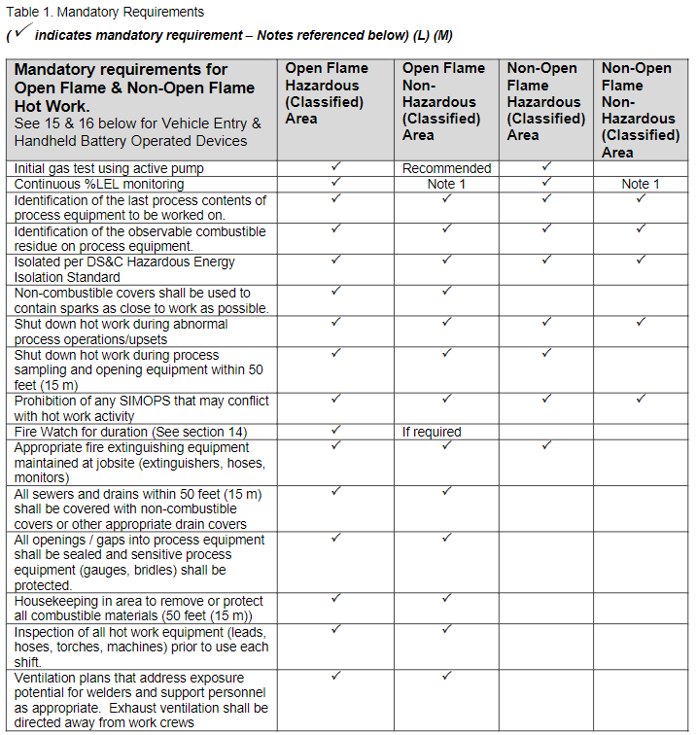
Job Site Preparation for a Hot Work
Other Requirements from the Hot Work Standard
Basic Requirements:
The table at right is out of the Hot Work Standard and lists the basic requirements for the different classifications of Hot Work.
It should be used as reference for job-site preparation
Refer Task Consequence Catalogue (TCC) to also know if the Start Work Checks form is required including other hazard analysis requirements for the hot work task.

Slide 29
Designated Safe Hot Work Area
A special exception is allowed for Non-Open Flame and Open Flame Hot Work inside a designated Safe Hot Work Area.
Designated Safe Hot Work Areas are typically maintenance shops but must be outside of hazardous (classified) areas.
All hot work conducted in the areas must be conducted in accordance with a site maintenance procedure / JSA with appropriate controls for identified hazards.
Area shall be clearly identified by signage –Posting of an annual permit is acceptable
Area shall be approved by BU management in consultation with health & safety /fire subject matter experts.
Areas shall be made of non-combustible or fire-resistant construction or adequately guarded/protected.
Areas shall be maintained free of flammable and combustible materials or such materials shall be adequately guarded/protected.
Areas shall be reassessed at least annually or when conditions change to ensure that these required conditions are maintained. Assessments shall be conducted more frequently to address higher risk locations.
Operations/Supply Chain Manager approval must be obtained for all annual Hot Work permits in accordance with the Hazard Analysis standard and the Task Consequence Catalogue.

Slide 30
Hot Work
Job Completion and Record Retention
Job Completion
When the work has been completed, the Permit Requester/Holder must return the General Work Permit, Hot Work Form and all related documents to the Permit Issuer
The Permit Issuer or the nominated Responsible Person will review the job site to ensure that:
      The work area has been left in a safe, clean and tidy condition
      Adequate time has elapsed for the Fire Watch to confirm that the work area has been left in a safe condition
      The work performed meets the specific work scope and task specifications
If the above conditions have been met the Issuer or Responsible Person will sign and date the General Work Permit and Hot Work Form as completed.
Record Retention
  Copies of all Hot Work Forms and associated documents retained one year or from audit to audit, whichever is the lesser
  If an accident occurred while work was in-progress, then documentation must be retained for incident investigation
  If permitted job involved potential health hazard, consider retaining permit documentation for an extended period (beyond 90 days).

